Slide 1


Introduction

Slide 2
History of Java
Java was originally developed by Sun Microsystems starting in 1991
James Gosling
Patrick Naughton
Chris Warth
Ed Frank
Mike Sheridan
This language was initially called Oak
Renamed Java in 1995

Slide 3
What is Java
A simple, object‐oriented, distributed, interpreted, robust, secure, architecture neutral, portable, high‐performance, multithreaded, and dynamic language ‐‐ Sun Microsystems
Object‐Oriented
No free functions
All code belong to some class
Classes are in turn arranged in a hierarchy or package structure

Slide 4
What is Java (2)
Distributed
Fully supports IPv4, with structures to support IPv6
Includes support for Applets: small programs embedded in HTML documents
Interpreted
The program are compiled into Java Virtual Machine (JVM) code called bytecode
Each bytecode instruction is translated into machine code at the time of execution

Slide 5
What is Java
Robust
Java is simple – no pointers/stack concerns
Exception handling – try/catch/finally series allows for simplified error recovery
Strongly typed language – many errors caught during compilation

Slide 6
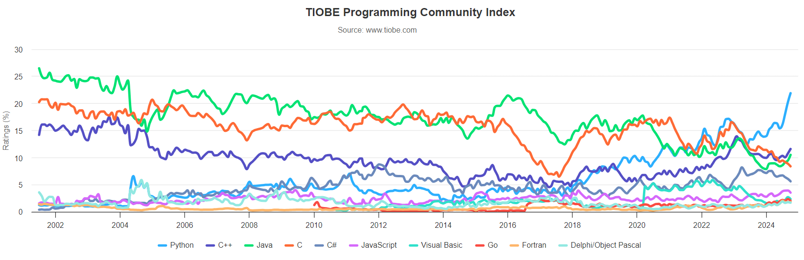
Java in TIOBE Programming Index
https://www.tiobe.com/tiobe-index/

Slide 7
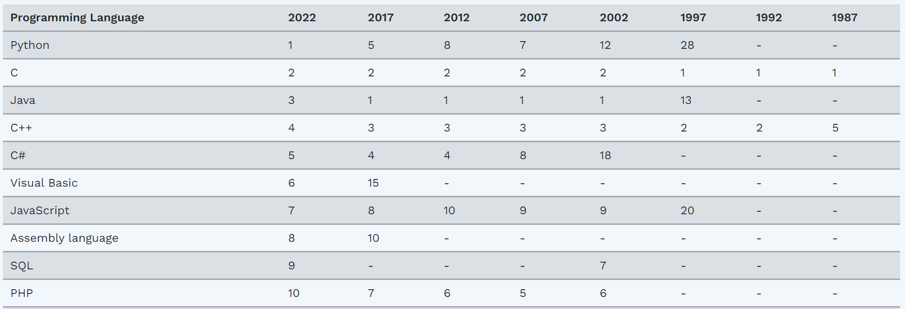
Java – The Most Popular (2002-2020)

Slide 8
Java Editions
Java 2 Platform, Standard Edition (J2SE)
Used for developing desktop-based applications and networking applications
Java 2 Platform, Enterprise Edition (J2EE)
Used for developing large‐scale, distributed networking applications and web‐based applications
Java 2 Platform, Micro Edition (J2ME)
Used for developing applications for small memory‐constrained devices, such as cell phones, pagers and PDAs

Slide 9
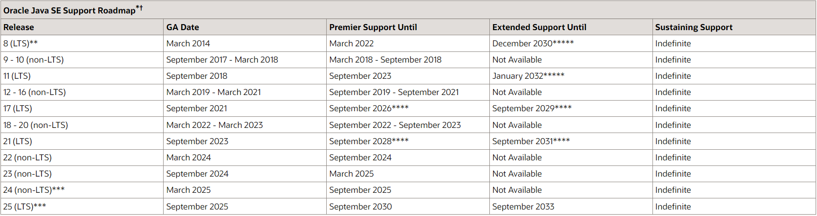
Java SE Versions

Slide 10
Installing Java
Download the JDK
From OpenJDK website or Oracle JDK downloads page
Run the Installer
Set Environment Variables
Add to “PATH” bin directory of JDK installation
Set “JAVA_HOME” to path of JDK installation directory
Verify Installation
java –version
javac -version

Slide 11




Java platform
public class HelloWorld
{
public static void main( String [] args )
{
System.out.println(“hello”);
}
}
Java Program ( Class File )
Java Platform
HelloWorld.java
Windows NT
Java API
Compile
javac
Java
Interpreter
Java Virtual Machine
Hardware-Based Platform
2387D47803 A96C16A484 54B646F541
06515EE464
Java Bytecode
Java
Interpreter
HelloWorld.class
Power Macintosh

Slide 12
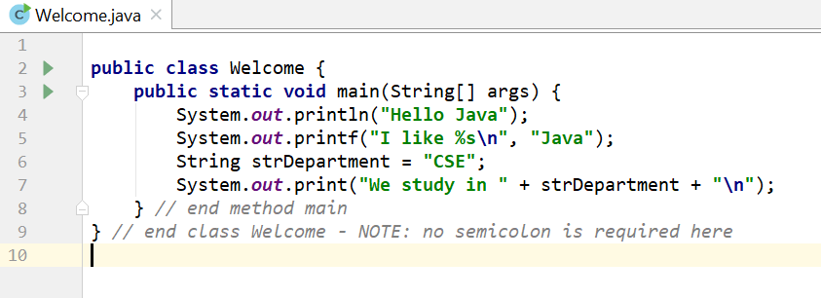
The First Java Program

Slide 13
Examining Welcome.java
A Java source file can contain multiple classes, but only one class can be a public class
Typically, Java classes are grouped into packages (similar to namespaces in C++)
A public class is accessible across packages
The source file name must match the name of the public class defined in the file with the .java extension

Slide 14
Examining Welcome.java
In Java, there is no provision to declare a class, and then define the member functions outside the class
Body of every member function of a class (called method in Java) must be written when the method is declared
Java methods can be written in any order in the source file
A method defined earlier in the source file can call a method defined later

Slide 15
Examining Welcome.java
public static void main(String[] args)
main is the starting point of every Java application
public is used to make the method accessible by all
static is used to make main a static method of class Welcome. Static methods can be called without using any object; just using the class name. JVM call main using the ClassName.methodName (Welcome.main) notation
void means main does not return anything
String args[ ] represents an array of String objects that holds the command line arguments passed to the application. Where is the length of args array?

Slide 16
Examining Welcome.java
Think of JVM as a outside Java entity who tries to access the main method of class Welcome
main must be declared as a public member of class Welcome
JVM wants to access main without creating an object of class Welcome
main must be declared as static
JVM wants to pass an array of String objects containing the command line arguments
main must take an array of String as parameter

Slide 17
Examining Welcome.java
System.out.println()
Used to print a line of text followed by a new line
System is a class inside the Java API
out is a public static member of class System
out is an object of another class of the Java API
out represents the standard output (similar to stdout or cout)
println is a public method of the class of which out is an object

Slide 18
Examining Welcome.java
System.out.print() is similar to System.out.println(), but does not print a new line automatically
System.out.printf() is used to print formatted output like printf() in C
In Java, characters enclosed by double quotes ("") represents a String object, where String is a class of the Java API
We can use the plus operator (+) to concatenate multiple String objects and create a new String object

Slide 19
Compiling a Java Program
Open a command prompt window and go to your working directory where the .java file is located
Execute the following command (path of java bin directory needs to be in PATH environment variable)
javac Welcome.java
If the source code is ok, then javac (the Java compiler) will produce a file called Welcome.class in the current directory

Slide 20
Compiling a Java Program
If the source file contains multiple classes then javac will produce separate .class files for each class
Every compiled class in Java will have their own .class file
.class files contain the bytecodes of each class
So, a .class file in Java contains the bytecodes of a single class only

Slide 21
Executing a Java Program
After successful compilation execute the following command
java Welcome
Note that we have omitted the .class extension here
The JVM will look for the class file Welcome.class and search for a public static void main(String args[ ]) method inside the class
If the JVM finds the above two, it will execute the body of the main method, otherwise it will generate an error and will exit immediately

Slide 22
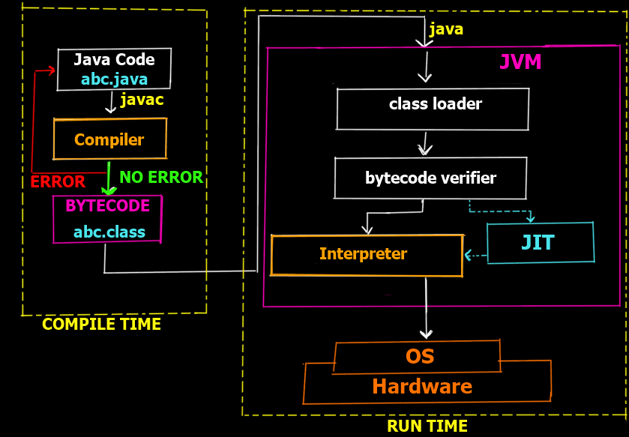
Java Development Environment
Edit
Create/edit the source code
Compile
Compile the source code
Load
Load the compiled code
Verify
Check against security restrictions
Execute
Execute the compiled

Slide 23
Phase 1: Creating a Program
Any text editor or Java IDE (Integrated Development Environment) can be used to develop Java programs
Java source‐code file names must end with the .java extension
Some popular Java IDEs are
IntelliJ
VS Code (with appropriate extensions)
NetBeans
Eclipse

Slide 24
Phase 2: Compiling a Java Program
javac Welcome.java
Searches the file in the current directory
Compiles the source file
Transforms the Java source code into bytecodes
Places the bytecodes in a file named Welcome.class

Slide 25
Bytecodes *
They are not machine language binary code
They are independent of any particular microprocessor or hardware platform
They are platform‐independent instructions
Another entity (interpreter) is required to convert the bytecodes into machine codes that the underlying microprocessor understands
This is the job of the JVM (Java Virtual Machine)

Slide 26
JVM (Java Virtual Machine) *
It is a part of the JDK and the foundation of the Java platform
It can be installed separately or with JDK
A virtual machine (VM) is a software application that simulates a computer, but hides the underlying operating system and hardware from the programs that interact with the VM
It is the JVM that makes Java a portable language

Slide 27
JVM (Java Virtual Machine) *
The same bytecodes can be executed on any platform containing a compatible JVM
The JVM is invoked by the java command
java Welcome
It searches the class Welcome in the current directory and executes the main method of class Welcome
It issues an error if it cannot find the class Welcome or if class Welcome does not contain a method called main with proper signature

Slide 28
Phase 3: Loading a Program *
One of the components of the JVM is the class loader
The class loader takes the .class files containing the programs bytecodes and transfers them to RAM
The class loader also loads any of the .class files provided by Java that our program uses

Slide 29
Phase 4: Bytecode Verification *
Another component of the JVM is the bytecode verifier
Its job is to ensure that bytecodes are valid and do not violate Java’s security restrictions
This feature helps to prevent Java programs arriving over the network from damaging our system

Slide 30
Phase 5: Execution
Now the actual execution of the program begins
Bytecodes are converted to machine language suitable for the underlying OS and hardware
Java programs go through two compilation phases
Source code ‐> Bytecodes
Bytecodes ‐> Machine language

Slide 31
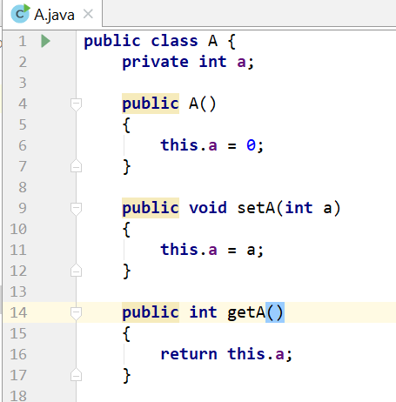
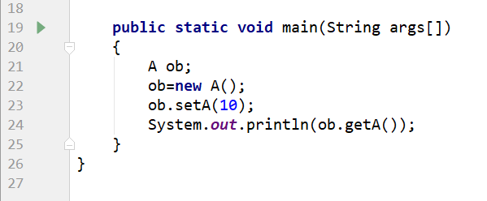
Another Java Program

Slide 32

Examining A.java
The variable of a class type is called a reference
ob is a reference to A object
Declaring a class reference is not enough, we have to use new to create an object
Every Java object has to be instantiated using keyword new
We access a public member of a class using the dot operator (.)
Dot (.) is the only member access operator in Java
Java does not have ->, & and *

Slide 33
Primitive (built‐in) Data types
Integers
byte 8‐bit integer (new)
short 16‐bit integer
int 32‐bit signed integer
long 64‐bit signed integer
Real Numbers
float 32‐bit floating‐point number
double 64‐bit floating‐point number
Other types
char 16‐bit, Unicode 2.1 character
boolean true or false, false is not 0 in Java

Slide 34
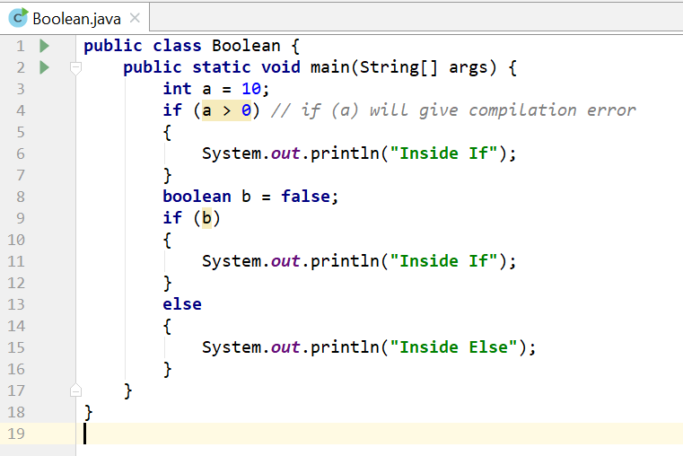
Boolean Type

Slide 35
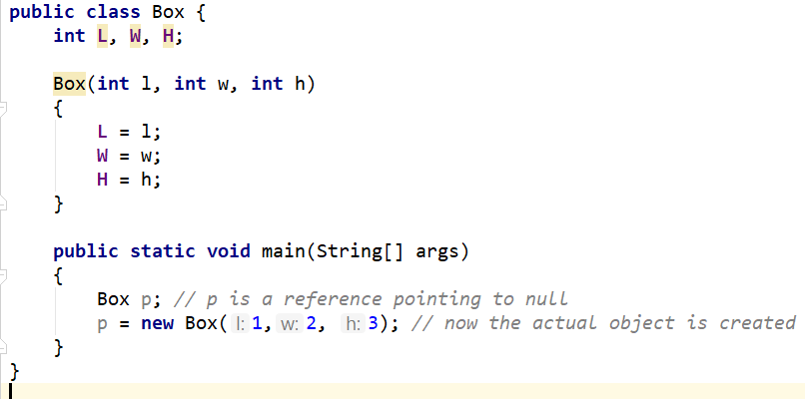
Non‐primitive Data types
The non‐primitive data types in java are
Objects
Array
Non‐primitive types are also called reference types

Slide 36
Primitive vs. Non‐primitive type
Primitive types are handled by value – the actual primitive values are stored in variable and passed to methods
int x = 10;
public MyPrimitive(int x) { }
Non‐primitive data types (objects and arrays) are handled by reference – the reference is stored in variable and passed to methods
Box b = new Box(1,2,3);
public MyNonPrimitive(Box x) { }

Slide 37
Primitive vs. Non‐primitive type
Primitive types are handled by value
There is no easy way to swap two primitive integers in Java
No method like void swap(int *x, int *y)
Can only be done using object or array
But do we actually need a method to swap?
x += (y - (y = x)) does the same in a single statement
Swap(int[] arr){
temp = arr[0];
arr[0] = arr[1];
arr[0] = temp;
}

Slide 38
Java References
Java references are used to point to Java objects created by new
Java objects are always passed by reference to other functions, never by value
Java references act as pointers but does not allow pointer arithmetic
We cannot read the value of a reference and hence cannot find the address of a Java object
We cannot take the address of a Java reference

Slide 39
Java is strictly pass by value
Non Primitive-
-passed by value(copy), no change found in
main
Primitive-
-reference is passed by value(copy of address)
so, address cannot be changed, but contents
are mutable

Slide 40
Java References
We can make a Java reference point to a new object
By copying one reference to another
ClassName ref2 = ref1; // Here ref1 is declared earlier
By creating a new object and assign it to the reference ClassName ref1 = new ClassName();
We cannot place arbitrary values to a reference except the special value null which means that the reference is pointing to nothing
ClassName ref1 = 100; // compiler error
ClassName ref2 = null; // no problem

Slide 41
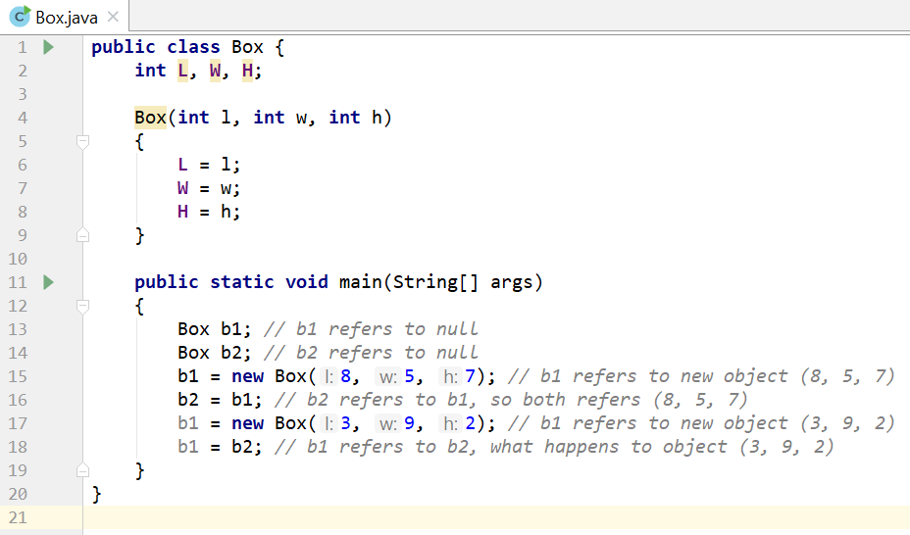
Java References

Slide 42
Array

Slide 43
Arrays
A group of variables containing values that all have the same type
Arrays are fixed‐length entities
In Java, arrays are objects, so they are considered reference types
But the elements of an array can be either primitive types or reference types

Slide 44
Arrays
We access the element of an array using the following syntax
name[index]
“index” must be a nonnegative integer
“index” can be int/byte/short/char but not long
In Java, every array knows its own length
The length information is maintained in a public final int member variable called length

Slide 45
Declaring and Creating Arrays
int c[ ] = new int [12]
Here, “c” is a reference to an integer array
“c” is now pointing to an array object holding 12 integers
Like other objects arrays are created using “new” and are created in the heap
“int c[ ]” represents both the data type and the variable name. Placing number here is a syntax error
int c[12]; // compiler error

Slide 46
Declaring and Creating Arrays
int[ ] c = new int [12]
Here, the data type is more evident i.e. “int[ ]”
But does the same work as
int c[ ] = new int [12]
Is there any difference between the above two approaches?

Slide 47
Declaring and Creating Arrays
int c[ ], x
Here, ‘c’ is a reference to an integer array
‘x’ is just a normal integer variable
int[ ] c, x;
Here, ‘c’ is a reference to an integer array (same as before)
But, now ‘x’ is also a reference to an integer array

Slide 48
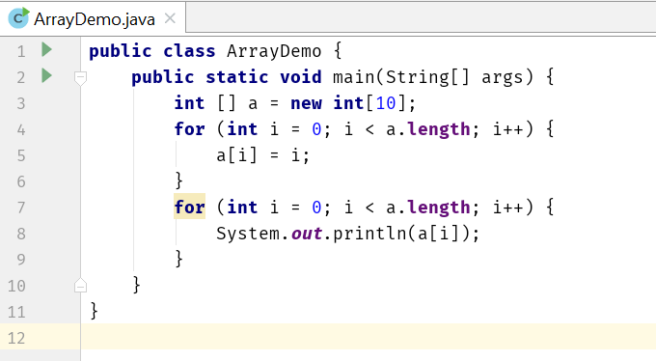
Arrays

Slide 49
Using an Array Initializer
We can also use an array initializer to create an array
int n[ ] = {10, 20, 30, 40, 50}
The length of the above array is 5
n[0] is initialized to 10, n[1] is initialized to 20, and so on
The compiler automatically performs a “new” operation taking the count information from the list and initializes the elements properly

Slide 50
Arrays of Primitive Types
When created by “new”, all the elements are initialized with default values
byte, short, char, int, long, float and double are initialized to zero
boolean is initialized to false
This happens for both member arrays and local arrays

Slide 51
Arrays of Reference Types
String [] str = new String[3]
Only 3 String references are created
Those references are initialized to null by default
Need to explicitly create and assign actual String objects in the above three positions.
str[0] = new String(“Hello”);
str[1] = “World”;
str[2] = “I” + “ Like” + “ Java”;

Slide 52
Arrays of Reference Types
class A {
private int a;
public int getA() {
return a;
}
public void setA(int a) {
this.a = a;
}
}
public class ArrayDemo2 {
public static void main(String[] args) {
A[] array = new A[10];
for (int i = 0; i < array.length; i++) {
array[i] = new A();
array[i].setA(i);
}
for (int i = 0; i < array.length; i++) {
System.out.println("Object of A: " + array[i].getA());
}
}
}

Slide 53
Passing Arrays to Methods
void modifyArray(double d[ ]) {…}
double [] temperature = new double[24];
modifyArray(temperature);
Changes made to the elements of ‘d’ inside “modifyArray” is visible and reflected in the “temperature” array
But inside “modifyArray” if we create a new array and assign it to ‘d’ then ‘d’ will point to the newly created array and changing its elements will have no effect on “temperature”

Slide 54
Passing Arrays to Methods
Changing the elements is visible, but changing the array reference itself is not visible
void modifyArray(double d[ ]) {
d[0] = 1.1; // visible to the caller
}
void modifyArray(double d[ ]) {
d = new double [10];
d[0] = 1.1; // not visible to the caller
}

Slide 55
Multidimensional Arrays
Can be termed as array of arrays.
int b[ ][ ] = new int[3][4];
Length of first dimension = 3
b.length equals 3
Length of second dimension = 4
b[0].length equals 4
int[ ][ ] b = new int[3][4];
Here, the data type is more evident i.e. “int[ ][ ]”

Slide 56
Multidimensional Arrays
int b[ ][ ] = { { 1, 2, 3 }, { 4, 5, 6 } };
b.length equals 2
b[0].length and b[1].length equals 3
All these examples represent rectangular two dimensional arrays where every row has same number of columns
Java also supports jagged array where rows can have different number of columns

Slide 57


Multidimensional Arrays
Example –1
int b[ ][ ];
b = new int[2][ ];
b[0] = new int[2];
b[1] = new int[3];
b[0][2] = 7; //will throw an exception
Example –2
int b[ ][ ] = { { 1, 2 }, { 3, 4, 5 } };
b[0][2] = 8; //will throw an exception
In both cases
b.length equals 2
b[0].length equals 2
b[1].length equals 3
Array ‘b’
Col 0
Col 1
Col 2
Row 0
Row 1
b[0][2] does not exist

Slide 58
Command Line Arguments

Slide 59
Using Command‐Line Arguments
java MyClass arg1 arg2 … argN
words after the class name are treated as command‐line arguments by Java
Java creates a separate String object containing each command‐line argument, places them in a String array and supplies that array to main
That’s why we have to have a String array parameter (String args[ ]) in main
We do not need a “argc” type parameter (for parameter counting) as we can easily use “args.length” to determine the number of parameters supplied.

Slide 60
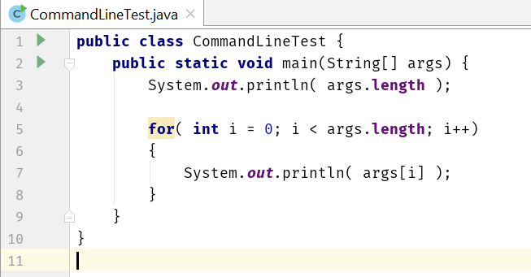
Using Command‐Line Arguments
3
Hello
2
You
java CommandLineTest Hello 2 You

Slide 61
For-Each

Slide 62
For‐Each version of the for loop
public class ForEachTest {
public static void main(String[] args) {
int numbers[] = {1, 2, 3, 4, 5};
for (int x : numbers) {
System.out.print(x + " ");
x = x * 10; // no effect on numbers
}
System.out.println();
int numbers2[][] = {{1, 2, 3}, {4, 5, 6}, {7, 8, 9}};
for (int[] x : numbers2) {
for (int y : x) {
System.out.print(y + " ");
}
System.out.println("");
} }
}
?

Slide 63
Scanner

Slide 64
Scanner
It is one of the utility class located in the java.util package
Using Scanner class, we can take inputs from the keyboard
Provides methods for scanning
int
float
double
line etc.

Slide 65
Scanner

Slide 66
JOptionPane

Slide 67
Static

Slide 68
Static Variables
When a member (both methods and variables) is declared static, it can be accessed before any objects of its class are created, and without reference to any object
Static variable
Instance variables declared as static are like global variables
When objects of its class are declared, no copy of a static variable is made

Slide 69
Static Methods & Blocks
Static method
They can only call other static methods
They must only access static data
They cannot refer to this or super in any way
Static block
Initialize static variables.
Get executed exactly once, when the class is first loaded

Slide 70
Static

Slide 71
Final
Declare a final variable, prevents its contents from being modified
final variable must be initialized when it is declared
It is common coding convention to choose all uppercase identifiers for final variables
final int FILE_NEW = 1;
final int FILE_OPEN = 2;
final int FILE_SAVE = 3;
final int FILE_SAVEAS = 4;
final int FILE_QUIT = 5;

Slide 72
Unsigned right shift operator
The >> operator automatically fills the high‐order bit with its previous contents each time a shift occurs
This preserves the sign of the value
But if you want to shift something that doesn’t represent a numeric value, you may not want the sign extension
Java’s >>> shifts zeros into the high‐order bit
int a= ‐1; | a = a >>>24;
11111111 | 11111111 | 11111111 | 11111111 | [‐1]
00000000 | 00000000 | 00000000 | 11111111 | [255]

Slide 73
Nested and Inner Classes

Slide 74
Nested Classes
It is possible to define a class within another classes, such classes are known as nested classes
The scope of nested class is bounded by the scope of its enclosing class. That means if class B is defined within class A, then B doesn’t exists without A
The nested class has access to the members (including private!) of the class in which it is nested
The enclosing class doesn’t have access to the members of the nested class

Slide 75
Static Nested Classes
Two types of nested classes.
Static
Non‐Static
A static nested class is one which has the static modifier applied. Because it is static, it must access the members of its enclosing class through an object
That is, it cannot refer to members of its enclosing class directly. Because of this restriction, static nested classes are seldom used

Slide 76
Static Nested Classes
class OuterStaticInner { private int outer_x = 100;
void test() {
Inner inner = new Inner();
inner.display(this);
} // this is a static nested class
static class Inner {
void display(OuterStaticInner outer) {
System.out.println(outer.outer_x);
}
}
} public class StaticNestedClassDemo {
public static void main(String[] args) {
OuterStaticInner outer = new OuterStaticInner();
outer.test();
OuterStaticInner.Inner x = new OuterStaticInner.Inner();
x.display(outer);
}
}

Slide 77
Static Nested Classes
class OuterStaticInner2 { private int outer_x = 100;
static int static_x = 200; // this is a static nested class
static class Inner {
int inner_x = 100; void print() {
// System.out.println(outer_x);
System.out.println(static_x);
System.out.println(inner_x);
}
}
}
public class StaticNestedClassDemo2 {
public static void main(String[] args) {
OuterStaticInner2.Inner x = new OuterStaticInner2.Inner();
x.print();
}
}

Slide 78
Inner Classes
The most important type of nested class is the inner class
An inner class is a non‐static nested class
It has access to all of the variables and methods of its outer class and may refer to them directly in the same way that other non‐static members of the outer class do
Thus, an inner class is fully within the scope of its enclosing class

Slide 79
Inner Classes
class Outer1 {
private int outer_x = 100; void test() {
Inner inner = new Inner();
inner.display();
} // this is an inner class
class Inner {
int inner_x = 200;
void display() {
System.out.println(outer_x);
}
}
} public class InnerClassDemo1 {
public static void main(String[] args) {
Outer1 outer = new Outer1();
outer.test();
Outer1.Inner innerObj = outer.new Inner();
innerObj.display();
}
}

Slide 80
Inner Classes
class Outer2
{
int outer_x = 100; void test() {
Inner inner = new Inner();
inner.display();
} class Inner {
int y = 10; // y is local to Inner
int outer_x = 200;
void display() {
System.out.println(Outer2.this.outer_x);
}
} void showy() {
//System.out.println(y); // error, y not known here!
}
} public class InnerClassDemo2 {
public static void main(String[] args) {
Outer2 outer = new Outer2();
outer.test();
}
}

Slide 81
Inner Classes
class Outer3 {
int outer_x = 100; void test() {
for (int i = 0; i < 5; i++) {
class Inner {
void display() {
System.out.println(outer_x);
}
}
Inner inner = new Inner();
inner.display();
}
}
}
public class InnerClassDemo3 {
public static void main(String[] args) {
Outer3 outer = new Outer3();
outer.test();
}
}

Slide 82
Inner Classes
class X {
int a = 10; void print() {
System.out.println("X");
System.out.println(a);
}
class Y {
int a = 20; void print() {
System.out.println("Y");
System.out.println(a);
System.out.println(X.this.a);
}
class Z {
int a = 30; void print() {
System.out.println("Z");
System.out.println(a);
System.out.println(Y.this.a);
System.out.println(X.this.a);
}
}
}
}
public class InnerClassDemo4 {
public static void
main(String[] args) {
X x = new X();
x.print();
X.Y y = x.new Y();
y.print();
X.Y.Z z = y.new Z();
z.print();
}
}

Slide 83
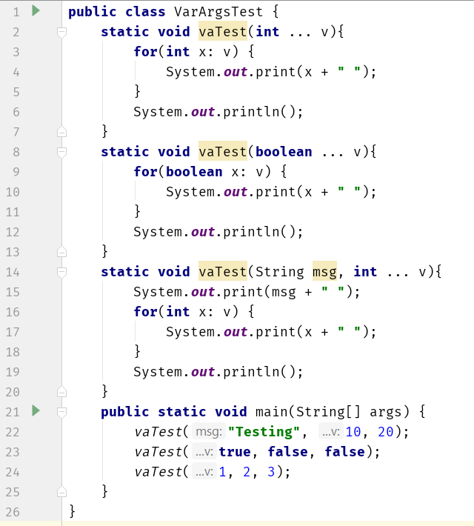
Variable Arguments

Slide 84
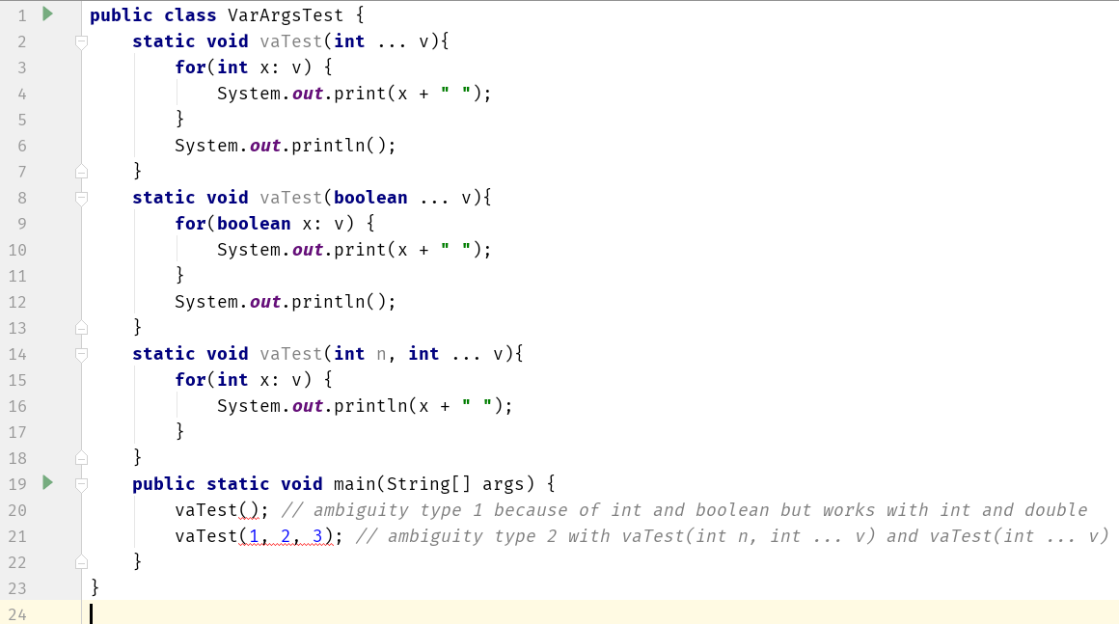
Variable Arguments Ambiguity

Slide 85
Local Variable Type Inference

Slide 86
Local Variable Type Inference
Recently added to the Java language (Java 10)
all variables must be declared prior to their use
a variable can be initialized with a value when it is declared
when a variable is initialized, the type of the initializer must be the same as the declared type of the variable
In principle, it would not be necessary to specify an explicit type for an initialized variable
it could be inferred by the type of its initializer

Slide 87
Local Variable Type Inference
Compiler infer the type of a local variable based on the type of its initializer without explicit specification
Advantages:
Streamline code by eliminating the need to redundantly specify a variable’s type when it can be inferred
Simplify declarations when the type name is quite lengthy, such as can be the case with some class names
Helpful when a type is difficult to determine
Its inclusion helps keep Java up-to-date with evolving trends in language design

Slide 88
Local Variable Type Inference
The context-sensitive identifier var was added to Java as a reserved type name
To use local variable type inference, the variable must be declared with var as the type name and it must include an initializer
double avg = 10.0; // type is explicitly specified
var avg = 10.0; // type is inferred as double because initializer (10.0) is of type double
var can still be used as user-defined identifier
int var = 1; // valid

Slide 89
Local Variable Type Inference
var cannot be used as the name of a class
var can be used to declare an array type, but cannot be used with an array initializer
var myArray = new int[10]; // valid
var myArray = { 1, 2, 3 }; // invalid
var is not allowed as an element type of an array
var[] myArray = new int[10]; // invalid
var myArray[] = new int[10]; // invalid

Slide 90
Local Variable Type Inference
var can be used to declare a variable only when that variable is initialized
var counter; // invalid
var cannot be used to declare a variable with null as the initializer
var can be used only to declare local variables, it cannot be used when declaring instance variables, parameters, or return types
var can be used in a for/for-each loop when declaring and initializing the loop control/iteration variable

Slide 91
Local Variable Type Inference
public class VarDemo {
public static void main(String[] args) {
var avg = 10.0;
System.out.println(avg);
int var = 1;
System.out.println(var);
var x = -var;
System.out.println(x);
// var y; // error
// var z = null; // error
var a = new int[10];
for(int i : a) {
System.out.print(i);
}
System.out.println();
for(var i : a) {
System.out.print(i);
}
System.out.println();
for(var k = 1; k < 10; k++) {
System.out.print(k);
}
System.out.println();
//var [] b = new int[10]; // error
//var b[] = new int[10]; // error
// var b = {1, 2, 3}; // error
}
}

Slide 92
Local Variable Type Inference
Local variable type inference can also be used with reference types
var str = “This is a string”;
Type inference is primarily used with reference types
Local variable type inference is especially effective in shortening declarations that involve long class names
Local variable type inference can also be used with user-defined classes
var mc = new MyClass();

Slide 93
Local Variable Type Inference
class MyClass{
private int x;
MyClass() {
this.x = 0;
}
void setX(int x) {
this.x = x;
}
int getX() {
return x;
}
}
public class RefVarDemo {
public static void main(String[] args) {
var mc = new MyClass();
System.out.println(mc.getX());
mc.setX(10);
System.out.println(mc.getX());
var str = "Hello World";
System.out.println(str);
}
}

Slide 94
Error Hunt
class A {
private int a;
int x;
final int CT_NO = 0;
static int st;
static {
st = -1;
}
A() {
a = x = 0;
CT_NO = 3;
st++;
}
void setVars(int arg) {
this.a = this.x = arg;
}
static void incr() {
a++;
st++;
}
class B {
int a;
void setVars(int a) {
A.a = a;
this.a = a;
st++;
}
}
public void main(String[] args) {
A ob1 = new A();
A ob2;
var ob3 = new A();
ob1.setVars(5);
ob2.incr();
B ob4 = new ob3.B();
ob4.setVars(10);
System.out.println(ob1.a);
System.out.println(ob2.st);
System.out.println(ob3.x);
System.out.println(ob4.a);
}
}

Slide 95
Strings

Slide 96
String related classes
Java provides four String related classes
java.lang package
String class: Storing and processing Strings but Strings created using the String class cannot be modified (immutable)
StringBuffer/StringBuilder class: Create flexible Strings that can be modified
java.util package
StringTokenizer class: Can be used to extract tokens from a String

Slide 97
String
String class provide many constructors and more than 40 methods for examining in individual characters in a sequence
You can create a String from a String value or from an array of characters.
String newString = new String(stringValue);
The argument stringValue is a sequence of characters enclosed inside double quotes
String message = new String (“Welcome”);
String message = “Welcome”;

Slide 98
String Constructors

Slide 99
String Length
Returns the length of a String
length()
Example:
String s1=“Hello”;
System.out.println(s1.length());

Slide 100
Extraction
Get the character at a specific location in a string
s1.charAt(1)
Get the entire set of characters in a string
s1.getChars(0, 5, charArray, 0)
public class StringTest {
public static void main(String[] args) {
String s = "Hello World";
char c1 = s.charAt(6);
System.out.println(c1);//W
char [] c2 = new char[5];
s.getChars(0, 5, c2, 0);
System.out.println(c2);//Hello
}
}

Slide 101
Extracting Substrings
substring method enable a new String object to be created by copying part of an existing String object
substring (int startIndex) ‐ copies the characters form the starting index to the end of the String
substring(int beginIndex, int endIndex) ‐ copies the characters from the starting index to one beyond the endIndex
public class StringSubstring {
public static void main(String[] args) {
String s = "Hello World";
String s1 = s.substring(6);
System.out.println(s1); //World
String s2 = s.substring(2,8);
System.out.println(s2); //llo Wo
}
}

Slide 102
String Comparisons
equals
Compare any two string objects for equality using lexicographical comparison. s1.equals(“hello”)
equalsIgnoreCase
s1.equalsIgnoreCase(s2)
compareTo
s1.compareTo(s2)
s1 > s2 (positive), s1 < s2 (negative), s1 = s2 (zero)

Slide 103
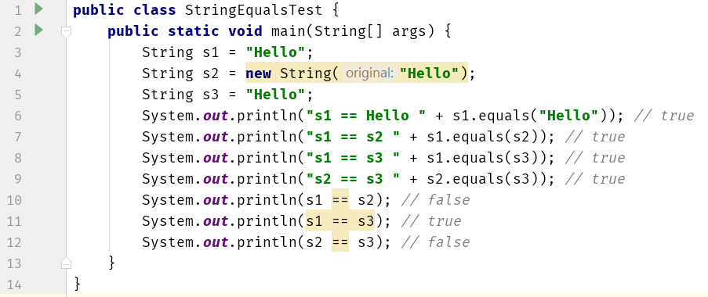
String Comparisons
For details have a look at section 1-4 from https://www.baeldung.com/java-string-pool

Slide 104
String Comparisons
regionMatches compares portions of two String objects for equality
s1.regionMatches (0, s2, 0, 5)
s1.regionMatches (true, 0, s2, 0, 5)
If the first argument is true, the method ignores the case of the characters being compared
startsWith and endsWith check whether a String starts or ends with a specified String
s1.startsWith (s2)
s1.endsWith (s2)

Slide 105
String Comparisons
public class StringTest {
public static void main(String[] args) {
String s = "Hello World";
String t = “hello ";
System.out.println(s.regionMatches(true, 0, t, 0, 6));//true
System.out.println(s.startsWith("Hello")); //true
System.out.println(s.endsWith("World")); //true
}
}

Slide 106
String Concatenation
Java provide the concat method to concatenate two strings.
s3 will be “Happy Birthday”
String s1 = new String (“Happy ”);
String s2 = new String (“Birthday”);
String s3 = s1.concat(s2);

Slide 107
String Search
Find the position of character/String within a String
int indexOf(char ch)
int lastIndexOf(char ch)
public class StringTest {
public static void main(String[] args) {
String s = "Hello World";
System.out.println(s.indexOf('o'));//4
System.out.println(s.lastIndexOf('o'));//7
}
}

Slide 108
String Conversions
Generally, the contents of a String cannot be changed once the string is created,
Java provides conversion methods
toUpperCase() and toLowerCase()
Converts all the characters in the string to lowercase or uppercase
trim()
Eliminates blank characters from both ends of the string
replace(oldChar, newChar)
Replaces a character in the string with a new character

Slide 109
String to Other Conversions
The String class provides valueOf methods for converting a character, an array of characters and numeric values to strings
valueOf method take different argument types

Slide 110
String to Other Conversions
Type | To String | From String
boolean | String.valueOf(boolean) | Boolean.parseBoolean(String)
byte | String.valueOf(int) | Byte.parseByte(String, int base)
short | String.valueOf(int) | Short.parseShort (String, int base)
Int | String.valueOf(int) | Integer.parseInt (String, int base)
long | String.valueOf(long) | Long.parseLong (String, int base)
float | String.valueOf(float) | Float.parseFloat(String)
double | String.valueOf(double) | Double.parseDouble(String)

Slide 111
String Conversion Example
To convert an int to a String (3 different ways):
int n = 123;
String s1 = Integer.toString(n);
String s2 = String.valueOf(n);
String s3 = n + "";
To convert a string to an int:
String s = “1234”;
int n = Integer.parseInt(s);

Slide 112
String Split
split() method splits a String against given regular expression and returns a character array
public class StringSplitTest {
public static void main(String[] args) {
String test = "abc,,def,123";
String[] out = test.split(",");
System.out.println(out.length);
for (int i = 0; i < out.length; i++) {
System.out.println(out[i]);
}
}
}

Slide 113
StringTokenizer
Break a string into pieces (tokens) so that contained information can be retrieved and processed
Specify a set of characters as delimiters when constructing a StringTokenizer object
StringTokenizer class is available since JDK 1.0 and the String.split() is available since JDK 1.4
String.split() does produce empty tokens, but StringTokenizer doesn't
StringTokenizer is a legacy class, retained for compatibility reasons, the use is discouraged!

Slide 114
StringTokenizer
Constructors
StringTokenizer(String str, String delim)
StringTokenizer(String str)
Methods
hasMoreToken() ‐ Returns true if there is a token left in the string
nextToken() ‐ Returns the next token in the string
nextToken(String delim) ‐ Returns the next token in the string after reseting the delimiter to delim
countToken( ) ‐ Returns the number of tokens remaining in the string tokenizer

Slide 115
StringTokenizer

Slide 116
StringBuffer/StringBuilder

Slide 117
StringBuffer
Can be used wherever a string is used
More flexible than String
Can add, insert, or append new contents into a string buffer
The StringBuffer class has three constructors and more than 30 methods for managing the buffer and for modifying strings in the buffer
Every StringBuffer is capable of storing a number of characters specified by its capacity

Slide 118
StringBuffer Constructors
public StringBuffer()
No characters in it and an initial capacity of 16 characters
public StringBuffer(int length)
No characters in it and an initial capacity specified by the length argument
public StringBuffer(String string)
Contains String argument and an initial capacity of the buffer is 16 plus the length of the argument

Slide 119
StringBuilder
The functionalities of StringBuilder is the same as StringBuffer, but StringBuilder is faster
StringBuffer is synchronized, StringBuilder is not
StringBuffer came first
Sun was concerned with correctness under all conditions, they made it synchronized to make thread-safe just in case
StringBuilder came later
Drop-in replacement for StringBuffer without the synchronization, not thread-safe

Slide 120
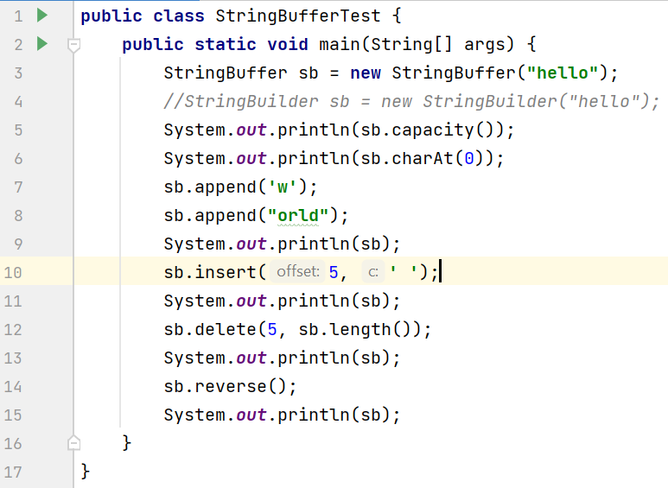
StringBuffer/StringBuilder

